Slide 1
        ANTI MALARIAL DRUGS
        BY
        N. KING’ORI
Antimalarial drugs by N. King'ori

Slide 2
MALARIA IN KENYA
Malaria is a disease caused by parasites of the genus Plasmodium.
Nationally, Plasmodium falciparum is the predominant species (98.2 per cent) while P. malariae, P.ovale is 1.8 per cent often occurring as mixed infections.
P.vivax may account for up to 40-50 per cent of infections (often mixed with P.falciparum) in the Northern and North Eastern parts of Kenya.
Antimalarial drugs by N. King'ori

Slide 3
CLASSIFICATION OF MALARIA
Malaria can be classified as either uncomplicated or severe based on clinical presentation.
UNCOMPLICATED MALARIA
This is characterized by fever in the presence of peripheral parasitaemia.
Other features may include chills, profuse sweating, muscle pains, joint pains, abdominal pain, diarrhoea, nausea, vomiting, irritability and refusal to feed.
These features may occur singly or in combination.
Antimalarial drugs by N. King'ori

Slide 4
SEVERE MALARIA
This is a life threatening manifestation of malaria, and is defined as the detection of P. falciparum in the peripheral blood in the presence of any of one or more of the clinical or laboratory features listed below:
Prostration (inability or difficulty to sit upright, stand or walk without support Šin a child normally able to do so, or inability to drink in children too young to sit)
Alteration in the level of consciousness (ranging from drowsiness to deep Šcoma)Cerebral malaria (unrousable coma not attributable to any other cause in a Špatient with falciparum malaria)
Respiratory distress (acidotic breathing)ŠMultiple generalized convulsions (2 or more episodes within a 24 hour Šperiod)
Antimalarial drugs by N. King'ori

Slide 5
Shock (circulatory collapse, septicaemia)Š
Pulmonary oedemaŠ
Abnormal bleeding (Disseminated Intravascular coagulopathy)Š
JaundiceŠ
Haemoglobinuria (black water fever)Š
Acute renal failure - presenting as oliguria or anuriaŠ
Severe anaemia (Haemoglobin < 5g/dl or Haematocrit < 15%)Š
Hypoglycaemia (blood glucose level < 2.2.mmol/l)
ŠHyperlactataemia
Antimalarial drugs by N. King'ori

Slide 6
TREATMENT OF UNCOMPLICATED FALCIPARUM MALARIA
First line treatment in all age groups
The recommended first line treatment for uncomplicated malaria in Kenya is artemether-lumefantrine (AL) currently available as a co-formulated regular or child friendly dispersible tablet containing 20mg of artemether and 120mg of lumefantrine.
This is administered as a 6-dose regimen given over three days
Antimalarial drugs by N. King'ori

Slide 7
Dosage (20mg of Artemether and 120mg of Lumefantrine).
WEIGHT DOSE
(kgs) DAY 1 DAY 2 DAY 3
5 – 14 1 tab BD 1 tab BD 1 tab BD
15- 24 2 tab BD 2 tab BD 2 tab BD
25 – 34 3 tab BD 3 tab BD 3 tab BD
ABOVE 34 4 tab BD 4 tab BD 4 tab BD
Antimalarial drugs by N. King'ori

Slide 8
TREATMENT OF SEVERE MALARIA
The recommended treatments for severe malaria are parenteral quinine or parenteral artemisinins (artesunate or artemether).
The preferred route of administration is the intravenous route.
However the intramuscular route can be used as an alternative where intravenous route is not feasible.
Antimalarial drugs by N. King'ori

Slide 9
ARTESUNATE
Artesunate is dispensed as a powder of artesunic acid.
This must be dissolved in sodium bicarbonate (5%) to form sodium artesunate.
The solution is then diluted in approximately 5 ml of 5% dextrose and given by intravenous injection or by intramuscular injection to the anterior thigh.
The solution should be freshly prepared prior to administration and should never be stored.Where available, artesunate is the preferred treatment for severe malaria in adults.
Administer artesunate as follows:
Dissolve artesunic powder with 5% sodium bicarbonate solution (provided with vial).
Dilute resultant solution with 5ml 5% dextrose
Administer 2.4 mg/kg stat by slow intravenous injection then 1.2 mg/kg/ at 12 hrs and 24 hrs then 1.2mg/kg daily until the patient is able to tolerate oral medications.
Artesunate can be given IM at the same dosage and intervals Thereafter a complete course of artemether-lumefantrine (AL) is given
Antimalarial drugs by N. King'ori

Slide 10
ARTEMETHER
Artemether is dispensed as clear oily solution of differing concentrations.
Artemether must only be given by intramuscular injection.
Administer artemether as follows:
Artemether administered by the intramuscular route at a loading dose of 3.2 mg/kg IM stat then 1.6 mg/kg/IM daily until the patient is able to tolerate oral medications
Thereafter a complete course of artemether-lumefantrine is given
Antimalarial drugs by N. King'ori

Slide 11
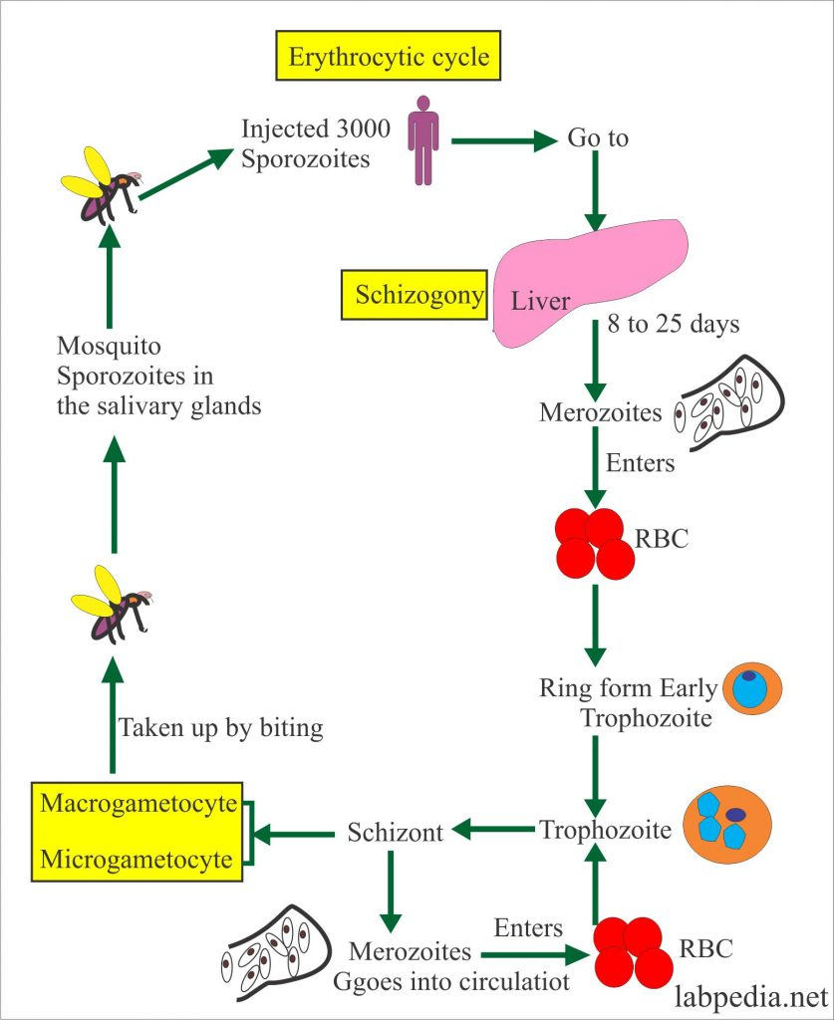
Antimalarial drugs by N. King'ori

Slide 12
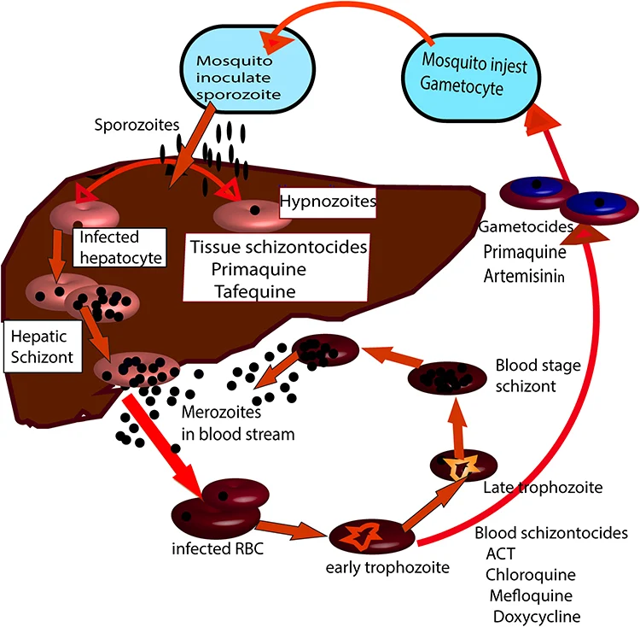
Antimalarial drugs by N. King'ori

Slide 13
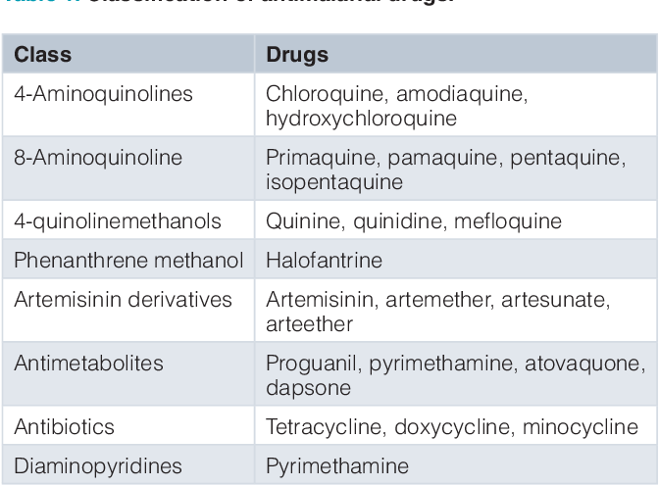
Antimalarial drugs by N. King'ori

Slide 14
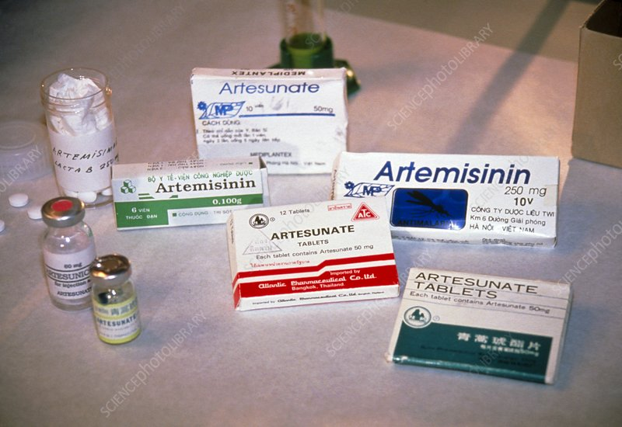
Antimalarial drugs by N. King'ori

Slide 15
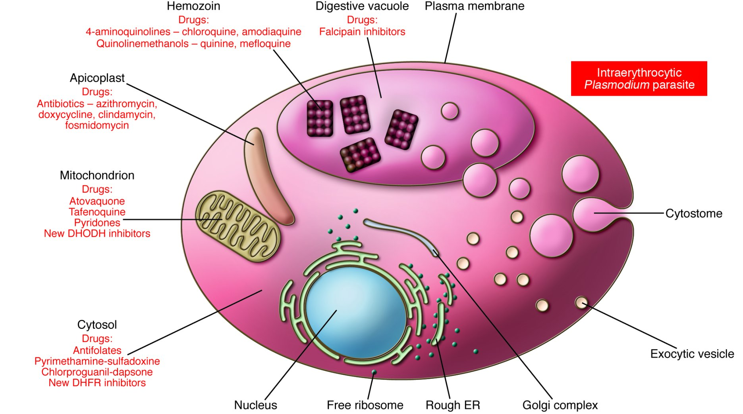
Antimalarial drugs by N. King'ori

Slide 16
        TREATMENT OF MALARIA:
Antimalarial drugs;
  4 – Methoxyquinolines;
    Quinine: 10mg / kg b.w per dose 8 hourly I.V or oral); severe infection
        Quinine + Clindamycin
        Quinine + Tetracycline
    Mefloquine + Artemisinin
        Mefloquine; used alone for prophylaxis
  4 – Aminoquinolines;
      Chloroquine
      Amodiaquine
  8 – Aminoquinolines;
      Primaquine – for eradication of exoerythrocytic forms of P. Vivax,
      P. Ovale and gametocidal against P. Falciparum.
(ADR: causes massive haemolysis in G 6PD – def.)
Antimalarial drugs by N. King'ori

Slide 17
Sulphonamides combination;
  Sulfadoxine / Pyrimethamine e.g. Fansidar
  Sulphamethoxypyridazine / pyrimethamine e.g.
  Metakelfin
Artemisinin derivatives – from Artemisia annua;
      Artemether e.g. Paluther
      Artesunate; a semi-synthetic artemisinin e.g. arsumax
      Dihydroartemisinin; the active metabolite of artemisinin
      e.g. cotecxin
  Artemether + lumefantrin = Coartem*
  Artesunate + Mefloquine = Arteqiun
  Artesunate + Amodiaquine = Larimal
  Artesunate + Sulphamethoxypyridazine + Pyrimethamine = Co-Arinate
  Dihydroartemisinin + Piperaquine = Duo-cotecxin
  Artemisinin 62.5mg + Piperaquine 375mg = Artequick
Antimalarial drugs by N. King'ori

Slide 18
Biguanides & other combinations;
    Proguanil 100mg + Atovaquone 250mg = malarone
    Proguanil alone used only in prophylaxis
9 – Phenanthrenemethanols;
    Halofantrine ( Halfan)
    lumefantrine; used only in combinations
Antimalarial drugs by N. King'ori

Slide 19
Antimalarial drugs include;
Quinine and related agents
Chloroquine
Amodiaquine
Pyrimethamine
Sulphadoxine
Proguanil
Mefloquine
Atovaquone
Primaquine
Artemisinin and derivatives
Halofantrine
Doxycycline
Clindamycin
Antimalarial drugs by N. King'ori

Slide 20
      QUININE AND RELATED AGENTS
Quinine has a long history stretching from Peru, and the discovery of the cinchona tree, and the potential uses of its bark, to the current day and a collection of derivatives that are still frequently used in the prevention and treatment of malaria.
Quinine is a 4 – Methoxyquinoline, an alkaloid that acts as a blood schizonticidal and weak gametocide against Plasmodium vivax and Plasmodium malariae.
It is especially useful in areas where there is known to be a high level of resistance to chloroquine, mefloquine, and sulfa drug combinations with pyrimethamine.
Quinine is also used in post-exposure treatment of individuals returning from an area where malaria is endemic.
Antimalarial drugs by N. King'ori

Slide 21
Quinimax and quinidine are the two most commonly used alkaloids related
to quinine in the treatment or prevention of malaria.
Quinimax is a combination of four alkaloids (quinine, quinidine, cinchoine
and cinchonidine). This combination has been shown in several studies to
be more effective than quinine, supposedly due to a synergistic action
between the four cinchona derivatives.
Quinidine is a direct derivative of quinine. It is a distereoisomer, thus having
similar anti-malarial properties to the parent compound. Quinidine is
recommended only for the treatment of severe cases of malaria.
Antimalarial drugs by N. King'ori

Slide 22
        Mechanism of action;
As an alkaloid, it is accumulated in the food vacuoles of Plasmodium species,
especially Plasmodium falciparum.
It acts by inhibiting the hemozoin biocrystallization, thus facilitating an
aggregation of cytotoxic heme.
Quinine is more toxic as a blood schizonticidal agent than chloroquine.
Antimalarial drugs by N. King'ori

Slide 23
      Pharmacokinetics
Doses can be given by oral, intravenous or intramuscular routes.
The oral bioavailability of quinine is 76 to 88% in healthy adults.
Quinine tablets may be administered without regard to meals.
Generally 10mg/kg b.w per dose every 8-hours is routinely given
(both I.V & oral)
Quinine is moderately protein-bound in blood of healthy subjects, ranging from 69
to 92%.
Quinine is metabolized almost exclusively via hepatic oxidative cytochrome
P450 (CYP) pathways.
Quinine is eliminated primarily via hepatic biotransformation.
Approximately 20% of quinine is excreted unchanged in urine. Because quinine is
reabsorbed when the urine is alkaline, renal excretion of the drug is twice as rapid
when the urine is acidic than when it is alkaline.
Antimalarial drugs by N. King'ori

Slide 24
      Adverse effects
Quinine can adversely affect almost every body system.
The most common adverse events associated with quinine use are a cluster of
symptoms called “cinchonism”, which occurs to some degree in almost all
patients taking quinine.
Symptoms of mild cinchonism include headache, vasodilation and sweating,
nausea, tinnitus, hearing impairment, vertigo or dizziness, blurred vision, and
disturbance in color perception.
More severe symptoms of cinchonism are vomiting, diarrhea, abdominal pain,
deafness, blindness, and disturbances in cardiac rhythm or conduction.
Most symptoms of cinchonism are reversible and resolve with discontinuation
of quinine.
Antimalarial drugs by N. King'ori

Slide 25
Hematologic: hypoprothrombinemia, hemolytic uremic syndrome (HUS),
thrombotic thrombocytopenic purpura, blackwater fever, aplastic anemia,
and lupus anticoagulant.
Neuropsychiatric: headache, diplopia, confusion, altered mental status,
seizures, coma,
Dermatologic: cutaneous rashes,
Respiratory: asthma, dyspnea, pulmonary edema.
Cardiovascular: atrioventricular block, irregular rhythm, QT prolongation
Gastrointestinal: nausea, vomiting, diarrhea, abdominal pain, gastric
irritation
Antimalarial drugs by N. King'ori

Slide 26
Hepatobiliary: granulomatous hepatitis, hepatitis, jaundice, and abnormal
liver function tests.
Metabolic: Quinine can cause hypoglycaemia through its action of
stimulating insulin secretion
Musculoskeletal: myalgias and muscle weakness.
Renal: hemoglobinuria, renal failure, renal impairment, and acute interstitial
nephritis.
Antimalarial drugs by N. King'ori

Slide 27
        CHLOROQUINE
Mechanism of action
Chloroquine is a 4-aminoquinoline compound with a complicated and still unclear mechanism of action.
Chloroquine is used in malaria treatment and prophylaxis where resistance is not encountered.
It is believed to reach high concentrations in the vacuoles of the parasite, which, due to its alkaline nature, raises the internal pH.
It controls the conversion of toxic heme to hemozoin by inhibiting the biocrystallization of hemozoin, thus poisoning the parasite through excess levels of toxicity.
Antimalarial drugs by N. King'ori

Slide 28
Other potential mechanisms through which it may act include interfering with the
biosynthesis of parasitic nucleic acids and the formation of a chloroquine-haem
or chloroquine-DNA complex.
The most significant level of activity found is against all forms of the schizonts
(with the obvious exception of chloroquine-resistant P. falciparum and P. vivax
strains)
Chloroquine also has a significant anti-pyretic and anti-inflammatory effect when
used to treat P. vivax infections.
Antimalarial drugs by N. King'ori

Slide 29
Pharmacokinetics
Recommendation by the WHO, involves giving an initial dose of 10 mg/kg
followed 6–8 hours later by 5 mg/kg, then 5 mg/kg on the following 2 days.
For chemoprophylaxis: 5 mg/kg/week (single dose) or 10 mg/kg/week divided
into 6 daily doses is advised. Chloroquine is only recommended as a prophylactic
Drug in regions only affected by P. vivax and sensitive P. falciparum strains.
It is considered very safe to use during pregnancy.
Antimalarial drugs by N. King'ori

Slide 30
Adverse effects
    gastrointestinal disturbances
    skin eruptions
    headache with visual disturbances
    hearing disorders / tinnitus
    blood dyscrasias
    skin photosensitivity
    myopathy
    Neuropathy
    Hypotension
    ECG changes
Antimalarial drugs by N. King'ori

Slide 31
        AMODIAQUINE
Amodiaquine is a 4-aminoquinoline anti-malarial drug similar in structure and
mechanism of action to Chloroquine.
It is thought to be more effective in clearing parasites in uncomplicated malaria
than Chloroquine, thus leading to a faster rate of recovery.
The drug should be given orally in doses between 25 mg/kg and 35 mg/kg
over 3 days in a similar method to that used in Chloroquine administration.
Antimalarial drugs by N. King'ori

Slide 32
Adverse effects
Adverse reactions are generally similar in severity and type to that seen in
Chloroquine treatment.
However, some fatal adverse effects of the drug were noted during the 1980s,
thus reducing its usage in chemoprophylaxis. The WHO's most recent advice on
the subject still maintains that the drug should be used when the potential risk of
not treating an infection outweighs the risk of developing side effects.
In addition, bradycardia, itching, nausea, vomiting, abdominal pain, blood and
hepatic disorders have been recorded.
Antimalarial drugs by N. King'ori

Slide 33
      PYRIMETHAMINE
  Indications
Treatment of Acute Malaria:
  It should not be used alone to treat acute malaria.
  Conjoint use of pyrimethamine with a sulfonamide (e.g. with sulfadoxine & sulphamethoxypyridazine to give fansidar & metakelfin respectively)
Chemoprophylaxis of Malaria:
  Indicated for the chemoprophylaxis of malaria due to susceptible strains of plasmodia.
  Resistance to pyrimethamine is however prevalent worldwide. It is not suitable as a prophylactic agent for travelers to most areas.
Treatment of Toxoplasmosis:
Used conjointly with a sulfonamide, since synergism exists with this combination.
Antimalarial drugs by N. King'ori

Slide 34
Mechanism of Action
Pyrimethamine acts by inhibiting dihydrofolate reductase in the parasite thus
preventing the biosynthesis of purines and pyrimidines. It therefore halts the
processes of DNA synthesis, cell division and reproduction. This activity is
primarily directed on the schizonts during the hepatic and erythrocytic phases.
It does not destroy gametocytes and is highly selective against plasmodia. It is
also active against Toxoplasma gondii.
Pyrimethamine possesses blood schizonticidal and some tissue schizonticidal
activity against malaria parasites of humans. However, the 4-amino-quinoline
compounds are more effective against the erythrocytic schizonts.
Antimalarial drugs by N. King'ori

Slide 35
Pharmacokinetics
Pyrimethamine (Daraprim) is an antiparasitic compound available in tablet form
(25mg) for oral administration.
Pyrimethamine is well absorbed with peak levels occurring between 2 to 6 hours
following administration.
Pyrimethamine is 87% bound to human plasma proteins.
It is eliminated slowly and has a plasma half-life of approximately 96 hours.
Antimalarial drugs by N. King'ori

Slide 36
Dose and Administration
Treatment of malaria
  Dosage of 25 mg daily for 2 days with a sulfonamide will initiate transmission control and suppression of non-falciparum malaria.
  25mg pyrimethamine + 500mg sulphadoxine = Fansidar
  25mg pyrimethamine + 500mg sulphamethoxypyridazine = Metakelfin
  For Chemoprophylaxis of Malaria:
      Adults and pediatric patients over 10 years — 25 mg (1 tablet) once weekly
      Children 4 through 10 years — 12.5 mg (1/2 tablet) once weekly
      Infants and children under 4 years — 6.25 mg (1/4 tablet) once weekly.
Antimalarial drugs by N. King'ori

Slide 37
Treatment of Toxoplasmosis:
  The adult starting dose is 50 to 75 mg of the drug daily, together with 1 to 4 g daily of a sulfonamide of the sulfapyrimidine type, e.g., sulfadoxine for 1 to 3 weeks, depending on the response of the patient and tolerance to therapy.
  Concurrent administration of folinic acid is strongly recommended in all patients (folinic acid dose 10mg OD)
Antimalarial drugs by N. King'ori

Slide 38
  Adverse effects;
Mainly hypersensitivity reactions including;
    Stevens-Johnson syndrome
    Toxic epidermal necrolysis (TEN)
    Erythema multiforme
    Anaphylaxis
Hyperphenylalaninemia, can occur particularly when pyrimethamine is
administered concomitantly with a sulfonamide.
Antimalarial drugs by N. King'ori

Slide 39
    Artemesinin and derivatives
Artemisinin is an antimalarial agent extracted from the dry leaves of the Chinese
herb Artemisia annua (qinghaosu or sweet wormwood).
Artemisinin has a very rapid action and the vast majority of acute patients
treated show significant improvement within 1–3 days of receiving treatment.
It has demonstrated the fastest clearance of all anti-malarials currently used and
acts primarily on the trophozite phase, thus preventing progression of the
disease.
Semi-synthetic artemisinin derivatives (e.g. artesunate, artemether) are easier to
use than the parent compound and are converted rapidly once in the body to the
active compound dihydroartemesinin.
Antimalarial drugs by N. King'ori

Slide 40
Pharmacokinetics
It is only used in combination therapy to prevent the development of resistance
for severe acute cases of drug-resistant P. falciparum.
On the first day of treatment 20 mg/kg should be given, this dose is then reduced
to 10 mg/kg per day for the 6 following days.
Antimalarial drugs by N. King'ori

Slide 41
    Adverse effects
Few side effects are associated with artemesinin use.
Common adverse effects include;
  Headaches
  Nausea / vomiting
  Abnormal bleeding
  Dark urine
  Itching
  Drug fever
Antimalarial drugs by N. King'ori

Slide 42
    Artemisinin Derivatives
Artemether;
Artemether is a methyl ether derivative of Dihydroartemesinin.
It is similar to Artemesinin in mode of action but demonstrates a reduced ability as a hypnozoiticidal compound, instead acting more significantly to decrease gametocyte carriage.
Similar restrictions are in place, as with Artemesinin, to prevent the development of resistance, therefore it is only used in combination therapy for severe acute cases of drug-resistant P. falciparum.
It should be administered in a 7 day course with 4 mg/kg given per day for 3 days, followed by 1.6 mg/kg for 3 days. Side effects of the drug are few but include potential neurotoxicity developing if high doses are given.
Antimalarial drugs by N. King'ori

Slide 43
Artesunate;
Artesunate is a hemisuccinate derivative of the active metabolite Dihydroartemisin.
Currently it is the most frequently used of all the Artemesinin-type drugs.
Its only effect is mediated through a reduction in the gametocyte transmission.
It is used in combination therapy and is effective in cases of uncomplicated P. falciparum.
The dosage recommended by the WHO is a 5 or 7 day course (depending on the predicted adherence level) of 4 mg/kg for 3 days (usually given in combination with Mefloquine) followed by 2 mg/kg for the remaining 2 or 4 days. In large studies carried out on over 10,000 patients in Thailand no adverse effects have been shown.
Antimalarial drugs by N. King'ori

Slide 44
Dihydroartemisinin;
Dihydroartemisinin is the active metabolite to which Artemesinin is reduced.
It is the most effective Artemesinin compound and the least stable.
It has a strong blood schizonticidal action and reduces gametocyte transmission.
It is used for therapeutic treatment of cases of resistant and uncomplicated P. falciparum. 4 mg/kg doses are recommended on the first day of therapy followed by 2 mg/kg for 6 days.
As with Artesunate, no side effects to treatment have thus far been recorded.
Antimalarial drugs by N. King'ori

Slide 45
Arteether;
Arteether is an ethyl ether derivative of Dihydroartemesinin.
It is used in combination therapy for cases of uncomplicated resistant
P. falciparum.
The recommended dosage is 150 mg/kg per day for 3 days given by IM injections.
With the exception of a small number of cases demonstrating neurotoxicity following parenteral administration no side effects have been recorded.
Antimalarial drugs by N. King'ori

Slide 46
      Mefloquine
Mefloquine was developed during the Vietnam War and is chemically related to
quinine. It was developed to protect American troops against multi-drug
resistant P. falciparum.
It is a very potent blood schizonticide with a long half-life and thought to act by
forming toxic heme complexes that damage parasitic food vacuoles.
Antimalarial drugs by N. King'ori

Slide 47
Indication & Dosing
Mefloquine is effective in prophylaxis and for acute therapy. It is now strictly
used for resistant strains (and is usually combined with Artesunate).
A dose of 15–25 mg/kg is recommended, depending on the prevalence of
Mefloquine resistance.
The effects during pregnancy are unknown. It is not recommended for use
during the first trimester, although considered safe during the second and
third trimesters.
Mefloquine can only be taken for a period up to 6 months (due to side effects)
following which other drugs again need to be taken.
Antimalarial drugs by N. King'ori

Slide 48
    Adverse effects
Mefloquine frequently produces side effects, including;
  GIT effects;
      nausea & vomiting
      Diarrhea / abdominal pain
  CNS effects;
      affective and anxiety disorders
      Hallucinations / dizziness
      sleep disturbances
      Psychosis
      toxic encephalopathy
      convulsions and delirium
  Cardiovascular effects;
      bradycardia and sinus arrhythmia
Antimalarial drugs by N. King'ori

Slide 49
Drug Interaction;
Concomitant administration of Mefloquine (Lariam) and other related compounds
(e.g., quinine, quinidine and chloroquine) may produce electrocardiographic
abnormalities and increase the risk of convulsions.
If these drugs are to be used in the initial treatment of severe malaria, Lariam
administration should be delayed at least 12 hours after the last dose.
There is evidence that the use of halofantrine after mefloquine causes a
significant lengthening of the QTc interval.
Antimalarial drugs by N. King'ori

Slide 50
      Primaquine
Primaquine is a highly active 8-aminoquinoline that is used in treating all types
of malaria infection.
It is most effective against gametocytes but also acts on hypnozoites, blood
schizonticytes and the dormant plasmodia in P. vivax and P. ovale.
It is the only known drug to cure both relapsing malaria infections and acute
cases.
      Mechanism of Action;
The mechanism of action is not fully understood but it is thought to mediate
some effect through creating oxygen free radicals that interfere with the
plasmodial electron transport chain during respiration.
Antimalarial drugs by N. King'ori

Slide 51
        Adverse effects
There are few significant side effects including;
  Dizziness & syncope
  Abdominal cramps
  Chest tightness
  Haemolysis in G6PD-deficiency
  Anaemia
  Suppression of myeloid activity
  Erythema multiforme & Steven Johnson syndrome
Antimalarial drugs by N. King'ori

Slide 52
      Halofantrine
Halofantrine is a relatively new drug developed by the Walter Reed Army
Institute of Research in the 1960s. It is a phenanthrene methanol.
It is chemically related to Quinine and acts as a blood schizonticide
effective against all plasmodium parasites.
Antimalarial drugs by N. King'ori

Slide 53
    Mechanism of Action
The mechanism of action is similar to other anti-malarials i.e. Cytotoxic
complexes are formed with ferritoporphyrin XI that cause plasmodial
membrane damage.
A dose of 8 mg/kg of Halofantrine is advised to be given in three doses at six
hour intervals for the duration of the clinical episode.
It has very variable bioavailability and has been shown to have potentially
high levels of cardiotoxicity.
It is not recommended for children under 10 kg despite data supporting the use
and demonstrating that it is well tolerated.
Antimalarial drugs by N. King'ori

Slide 54
    Adverse effects
The most frequently experienced side-effects include;
  Nausea
  Abdominal pain & diarrhoea
  Pruritus
  Severe ventricular dysrhythmias due to prolongation of the QTc interval.
Halofantrine is not recommended for use in pregnancy and lactation, in small
children, or in patients who have taken Mefloquine previously.
Antimalarial drugs by N. King'ori

Slide 55
        Proguanil
Proguanil (Chloroguanadine) is a biguanide; a synthetic derivative of
pyrimidine.
It was developed in 1945 by a British Antimalarial research group.
It has no known effect against hypnozoites therefore is not used in the
prevention of relapse.
It has a weak blood schizonticidal activity and is not recommended for
therapy of acute infection.
However it is useful in prophylaxis when combined with Atovaquone i.e.
Malarone.
The Proguanil- Chloroquine combination does not provide effective protection
against resistant strains of P. falciparum.
Antimalarial drugs by N. King'ori

Slide 56
Mechanism of Action & Pharmacokinetics / Adverse effects;
Proguanil has many mechanisms of action but primarily is mediated through
conversion to the active metabolite cycloguanil pamoate. This inhibits the malarial
dihydrofolate reductase enzyme.
3 mg/kg is the advised dosage per day, (hence approximate adult dosage is
200 mg).
The pharmacokinetic profile of the drugs indicates that a half dose, twice daily
maintains the plasma levels with a greater level of consistency, thus giving a
greater level of protection.
There are very few side effects to Proguanil, with slight hair loss and mouth
ulcers being occasionally reported following prophylactic use.
Antimalarial drugs by N. King'ori

Slide 57
      Doxycycline
Probably one of the more prevalent antimalarial drugs prescribed, due to its
relative effectiveness and cheapness, doxycycline is a tetracycline compound
derived from oxytetracycline.
Doxycycline is used primarily for chemoprophylaxis in areas where chloroquine
resistance exists.
It can also be used in combination with quinine to treat resistant cases of
P. falciparum but has a very slow action in acute malaria, and should not be
used as monotherapy.
Antimalarial drugs by N. King'ori

Slide 58
  Mechanism of Action;
Doxycycline is a bacteriostatic agent that acts to inhibit the process of protein
synthesis by binding to the 30S ribosomal subunit thus preventing the 50s and
30s units from bonding.
  Indication & Dosing;
When treating acute cases and given in combination with quinine; 100 mg of
doxycycline should be given per day for 7 days.
In prophylactic therapy, 100 mg (adult dose) of doxycycline should be given every
day; 1-week before exposure, during exposure and 1-week after exposure to
malaria.
Antimalarial drugs by N. King'ori

Slide 59
      Adverse effects
The most commonly experienced side effects are;
    permanent enamel hypoplasia
    transient depression of bone growth
    gastrointestinal disturbances
    photosensitivity.
Due to its effect of bone and tooth growth it is not used in children under 8,
pregnant or lactating women and those with a known hepatic dysfunction.
Antimalarial drugs by N. King'ori

Slide 60
      Clindamycin
Clindamycin is a derivative of Lincomycin, with a slow action against blood
schizonticides.
It is only used in combination with Quinine in the treatment of acute cases of
resistant P. falciparum infections and not as a prophylactic.
Being more expensive and toxic than the other antibiotic alternatives, it is used
only in cases where the Tetracyclines are contraindicated (for example in
children).
Clindamycin should be given in conjunction with Quinine as a 300 mg dose (in
adults) four times a day for 5 days.
Antimalarial drugs by N. King'ori

Slide 61
      Adverse Effects
The side effects recorded in patients taking Clindamycin are;
    nausea
    vomiting
    abdominal pains and cramps.
    Pseudomembranous colitis (caused by Clostridium difficile)
These adverse effects can however be alleviated by consuming large quantities
of water and food when taking the drug.
Pseudomembranous colitis also develops in some patients; this condition may be
fatal in a small number of cases.
Antimalarial drugs by N. King'ori

Slide 62
      Atovaquone
Atovaquone is only available in combination with Proguanil under the name
Malarone.
It is most commonly used as prophylaxis by travelers; also used for treatment of acute attack of malaria.
Antimalarial drugs by N. King'ori

Slide 63
Chemoprophylaxis drugs:
Proguanil (paludrine) 200mg daily for 1 – 2 days before exposure, then daily
during exposure and 4 weeks after exposure.
Mefloquine ( larium): 250mg once weekly ¹/₅₂ before exposure , during
exposure and ⁴/₅₂ post exposure.
Chloroquine (In sensitive areas): 300mg once weekly for ¹/₅₂ before exposure,
during exposure and ⁴/₅₂ after exposure
Doxycline 100mg daily for ¹/₅₂ before exposure, during exposure and 4 weeks
after exposure.
Malarone (proguanil + atovaquone); 1-tab OD 1-2 days before exposure,
during exposure and 4-weeks after exposure.
Antimalarial drugs by N. King'ori

Slide 64
Drugs used for the Prevention of Malaria in Travellers
Drug | Use | Adult Dosage
Chloroquine | Areas without resistant P falciparum | 500 mg weekly
Malarone | Areas with multidrug-resistant P falciparum | 1 tablet (250 mg atovaquone/100 mg proguanil) daily
Mefloquine | Areas with chloroquine-resistant P falciparum | 250 mg weekly
Doxycycline | Areas with multidrug-resistant P falciparum | 100 mg daily
Primaquine | Terminal prophylaxis of P vivax and P ovale infections | 26.3 mg (15 mg base) daily for 14 days after travel
Antimalarial drugs by N. King'ori

